Slide 1
CSE 2202 Design and Analysis of Algorithms – I All Pair Shortest Path

Slide 2
All-Pairs Shortest Paths - Solutions
Run BELLMAN-FORD once from each vertex:
O(V²E), which is O(V⁴) if the graph is dense (E = Θ(V²))
If no negative-weight edges, could run Dijkstra’s algorithm once from each vertex:
O(VElgV) with binary heap, O(V³lgV) if the graph is dense
We can solve the problem in O(V³), with no elaborate data structures

Slide 3
All-Pairs Shortest Paths
2
Assume the graph (G) is given as adjacency matrix of weights
W = (w_{ij}), n x n matrix, |V| = n
Vertices numbered 1 to n
if i = j
w_{ij} = if i ≠ j , (i, j) ∈ E
if i ≠ j , (i, j) ∉ E
Output the result in an n x n matrix
D = (d_{ij}), where d_{ij} = δ(i, j)
Solve the problem using dynamic programming
3
4
1
8
3
2
-4
1
-5
7
0
5
4
6
weight of (i, j)
∞

Slide 4
Optimal Substructure of a Shortest Path
at most m edges
All subpaths of a shortest path are shortest paths
Let p: a shortest path p from vertex i to j that contains at most m edges
If i = j
w(p) = 0 and p has no edges
∞
11
j
i
k
at most m - 1 edges
p’
If i ≠ j: p = i k → j
p’ has at most m-1 edges
p’ is a shortest path
δ(i, j) =
δ(i, k) + w_{kj}

Slide 5
The Floyd-Warshall Algorithm
Given:
Directed, weighted graph G = (V, E)
Negative-weight edges may be present
No negative-weight cycles could be present in the graph
Compute:
The shortest paths between all pairs of vertices in a graph
2
3
4
1
8
3
2
-4
1
-5
7
5
4
6

Slide 6
The Structure of a Shortest Path
For any pair of vertices i, j ∈ V, consider all paths from i to j whose intermediate vertices are all drawn from a subset {1, 2, …, k}
Find p, a minimum-weight path from these paths
p₁
i
p_{u}
j
p_{t}
No vertex on these paths has index > k

Slide 7
Example
d_{ij}^{(k)} = the weight of a shortest path from vertex i to vertex j with all intermediary vertices drawn from {1, 2, …, k}
d₁₃⁽⁰⁾ =
d₁₃⁽¹⁾ =
d₁₃⁽²⁾ =
d₁₃⁽³⁾ =
d₁₃⁽⁴⁾ =
6
6
3
6
0.5
1
2
5
3
4
2
1
5
4.5

Slide 8
The Structure of a Shortest Path
k is not an intermediate vertex of path p
Shortest path from i to j with intermediate vertices from {1, 2, …, k} is a shortest path from i to j with intermediate vertices from {1, 2, …, k - 1}
k is an intermediate vertex of path p
p₁ is a shortest path from i to k
p₂ is a shortest path from k to j
k is not intermediary vertex of p₁, p₂
p₁ and p₂ are shortest paths from i to k with vertices from {1, 2, …, k - 1}
k
i
j
p₁
∞
p₂
k
j
i

Slide 9
A Recursive Solution (cont.)
d_{ij}^{(k)} = the weight of a shortest path from vertex i to vertex j with all intermediary vertices drawn from {1, 2, …, k}
k = 0
d_{ij}^{(k)} =
w_{ij}

Slide 10
A Recursive Solution (cont.)
d_{ij}^{(k)} = the weight of a shortest path from vertex i to vertex j with all intermediary vertices drawn from {1, 2, …, k}
k ≥ 1
Case 1: k is not an intermediate vertex of path p
d_{ij}^{(k)} =
k
i
j
d_{ij}^{(k-1)}

Slide 11
A Recursive Solution (cont.)
d_{ij}^{(k)} = the weight of a shortest path from vertex i to vertex j with all intermediary vertices drawn from {1, 2, …, k}
k ≥ 1
Case 2: k is an intermediate vertex of path p
d_{ij}^{(k)} =
∞
k
j
i
d_{ik}^{(k-1)} + d_{kj}^{(k-1)}

Slide 12
Computing the Shortest Path Weights
d_{ij}^{(k)} = w_{ij} if k = 0
min {d_{ij}^{(k-1)} , d_{ik}^{(k-1)} + d_{kj}^{(k-1)} } if k ≥ 1
The final solution: D^{(n)} = (d_{ij}^{(n)}):
d_{ij}^{(n)} = δ(i, j) ∀ i, j ∈ V
j
j
+
(k, j)
i
i
(i, k)
D^{(k-1)}
D^{(k)}

Slide 13
The Floyd-Warshall algorithm
Floyd-Warshall(W[1..n][1..n])
01 D ← W // D⁽⁰⁾
02 for k ← 1 to n do // compute D^{(k)}
03 for i ←1 to n do
04 for j ←1 to n do
05 if D[i][k] + D[k][j] < D[i][j] then
06 D[i][j] ← D[i][k] + D[k][j]
07 return D
Running Time: O(n³)

Slide 14
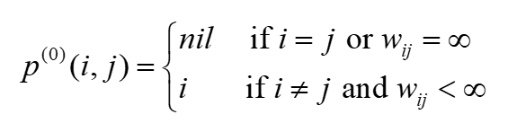
Computing predecessor matrix
How do we compute the predecessor matrix?
Initialization:
Floyd-Warshall(W[1..n][1..n])
01 …
02 for k ← 1 to n do // compute D^{(k)}
03 for i ←1 to n do
04 for j ←1 to n do
05 if D[i][k] + D[k][j] < D[i][j] then
06 D[i][j] ← D[i][k] + D[k][j]
07 P[i][j] ← k
08 return D

Slide 15
Example
d_{ij}^{(k)} = min {d_{ij}^{(k-1)} , d_{ik}^{(k-1)} + d_{kj}^{(k-1)} }
D⁽⁰⁾ = W
D⁽¹⁾
2
1
2
3
4
5
1
2
3
4
5
3
4
1
0 | 3 | 8 | ∞ | -4
∞ | 0 | ∞ | 1 | 7
∞ | 4 | 0 | ∞ | ∞
2 | ∞ | -5 | 0 | ∞
∞ | ∞ | ∞ | 6 | 0
1
0
3
8
∞
-4
1
8
3
2
2
∞
0
∞
1
7
2
1
3
3
∞
4
0
∞
∞
-4
7
-5
5
4
4
4
2
5
-5
0
-2
6
5
5
∞
∞
∞
6
0
D⁽²⁾
1
2
3
4
5
D⁽³⁾
D⁽⁴⁾
1
0
3
8
4
-4
0
3
8
4
-4
0
3
-1
4
-4
2
∞
0
∞
1
7
∞
0
∞
1
7
3
0
-4
1
-1
3
∞
4
0
5
11
∞
4
0
5
11
7
4
0
5
3
4
2
5
-5
0
-2
2
-1
-5
0
-2
2
-1
-5
0
-2
5
∞
∞
∞
6
0
∞
∞
∞
6
0
8
5
1
6
0

Slide 16
Example
d_{ij}^{(k)} = min {d_{ij}^{(k-1)} , d_{ik}^{(k-1)} + d_{kj}^{(k-1)} }
D⁽⁵⁾
P⁽⁵⁾
2
1
2
3
4
5
1
2
3
4
5
3
4
1
0 | 1 | -3 | 2 | -4
3 | 0 | -4 | 1 | -1
7 | 4 | 0 | 5 | 3
2 | -1 | -5 | 0 | -2
8 | 5 | 1 | 6 | 0
1
-
3
4
5
1
1
8
3
2
2
4
-
4
2
1
2
1
3
3
4
3
-
2
1
-4
7
-5
5
4
4
4
4
3
4
-
1
6
5
5
4
3
4
5
-
Source: 5, Destination: 1
Shortest path: 8
Path: 5 …1 : 5…4…1: 5->4…1: 5->4->1
Source: 1, Destination: 3
Shortest path: -3
Path: 1 …3 : 1…4…3: 1…5…4…3: 1->5->4->3

Slide 17
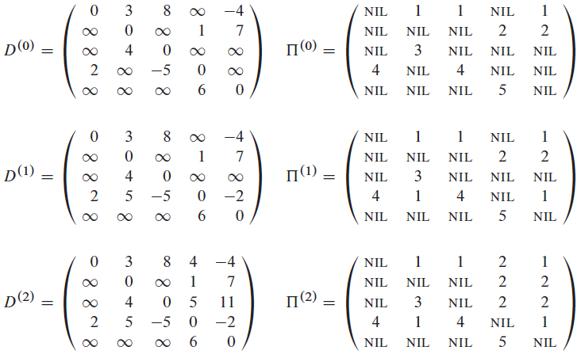
Example
d_{ij}^{(k)} = min {d_{ij}^{(k-1)} , d_{ik}^{(k-1)} + d_{kj}^{(k-1)} }
2
3
4
1
8
3
2
-4
1
-5
7
5
4
6

Slide 18
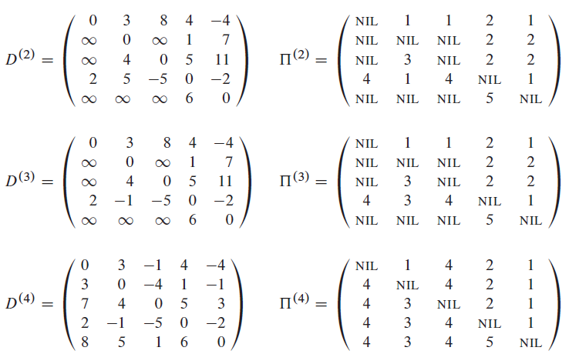
Example
d_{ij}^{(k)} = min {d_{ij}^{(k-1)} , d_{ik}^{(k-1)} + d_{kj}^{(k-1)} }
2
3
4
1
8
3
2
-4
1
-5
7
5
4
6

Slide 19
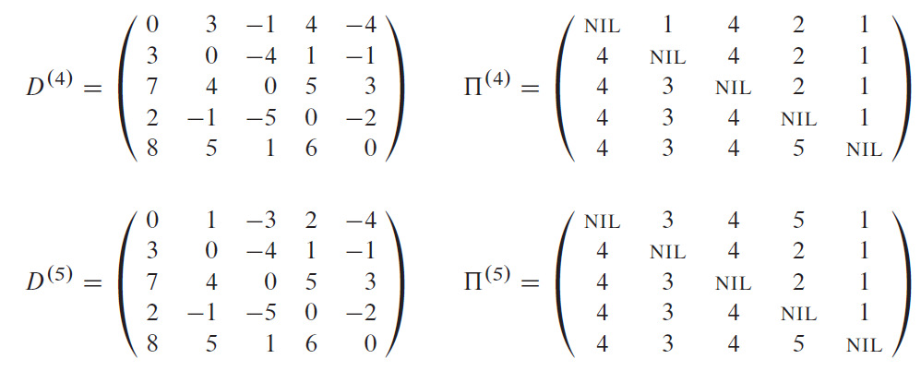
Example
d_{ij}^{(k)} = min {d_{ij}^{(k-1)} , d_{ik}^{(k-1)} + d_{kj}^{(k-1)} }
2
3
4
1
8
3
2
-4
1
-5
7
5
4
6

Slide 20
PrintPath for Warshall’s Algorithm
PrintPath(s, t)
{
if(P[s][t]==nil) {print(“No path”);return;}
else if (P[s][t]==s){
print(s);
}
else{
print_path(s,P[s][t]);
print_path(P[s][t], t);
}
}
Print (t) at the end of the PrintPath(s,t)

Slide 21
Question
Why should we use D[i, j] instead of D^{(k)}[i, j]?
Exercise:
25.2-4: Memory O(n²)
25.2-6: Negative weight cycle
Find the shortest positive cycle

Slide 22
Transitive closure of the graph
Input:
Un-weighted graph G: W[i][j] = 1, if (i,j)∈E, W[i][j] = 0 otherwise.
Output:
T[i][j] = 1, if there is a path from i to j in G, T[i][j] = 0 otherwise.
Algorithm:
Just run Floyd-Warshall with weights 1, and make T[i][j] = 1, whenever D[i][j] < ∞.
More efficient: use only Boolean operators

Slide 23
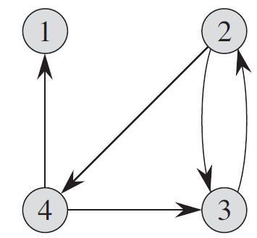
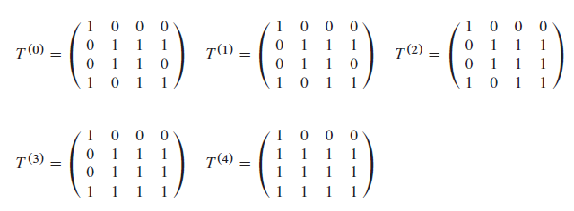
Transitive closure algorithm
Transitive-Closure(W[1..n][1..n])
01 T ← W // T⁽⁰⁾
02 for k ← 1 to n do // compute T^{(k)}
03 for i ←1 to n do
04 for i ←1 to n do
05 T[i][j] ← T[i][j] ∨ (T[i][k] ∧ T[k][j])
06 return T

Slide 24

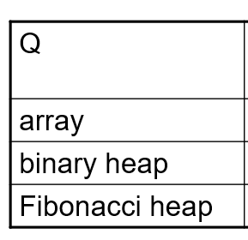
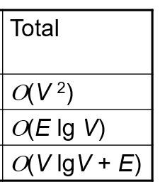
Complexity
Bellman-Ford algorithm:
Dijkstra’s Algorithm

Slide 25
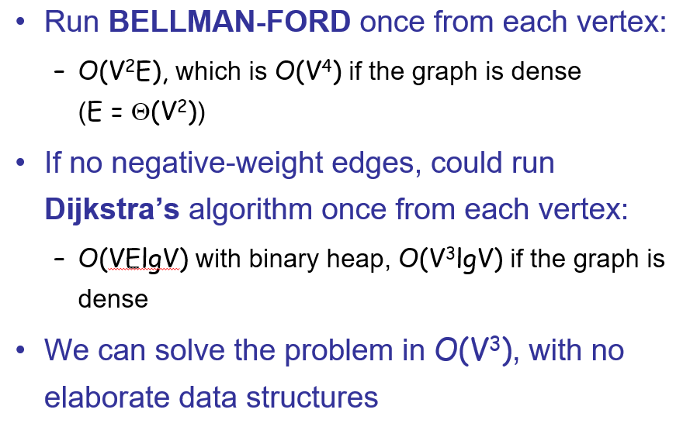
Complexity
Bellman-Ford algorithm:
Dijkstra’s Algorithm

Slide 26
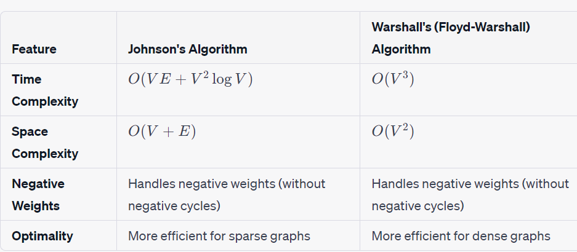
Johnson’s Algorithm
Time Complexity: The main steps in the algorithm are Bellman-Ford Algorithm called once and Dijkstra called V times.
Time complexity of Bellman Ford is O(VE) and time complexity of Dijkstra is O(VLogV). So overall time complexity is O(V²log V + VE).

Slide 27

Johnson’s Algorithm
Johnson’s algorithm uses the technique of reweighting
If all edge weights w in a graph G are nonnegative, we can find shortest paths between all pairs of vertices by running Dijkstra’s algorithm once from each vertex;
with the Fibonacci-heap min-priority queue, the running time of this all-pairs algorithm is
If G has negative-weight edges but no negative-weight cycles, we simply compute a new set of nonnegative edge weights that allows us to use the same method…

Slide 28
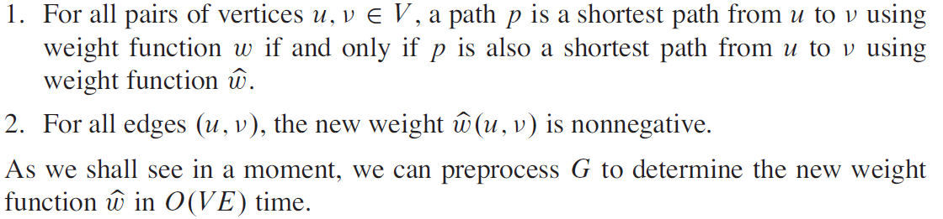
Johnson’s Algorithm
The new set of edge weights must satisfy two important properties:

Slide 29
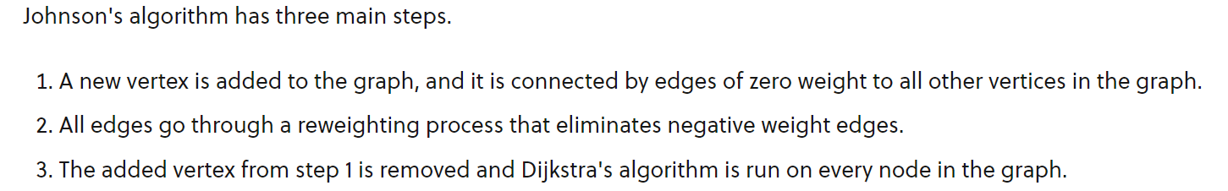
Johnson’s Algorithm

Slide 30
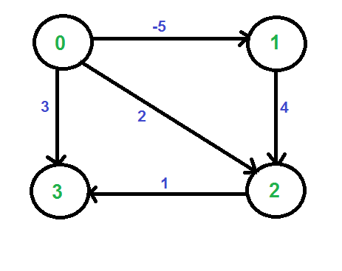
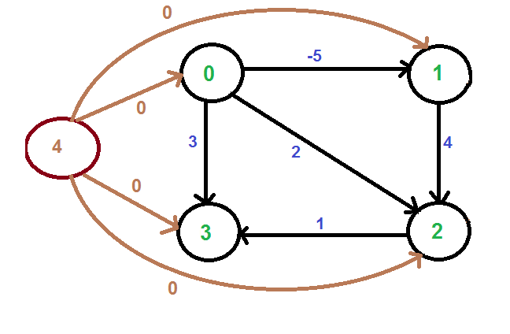
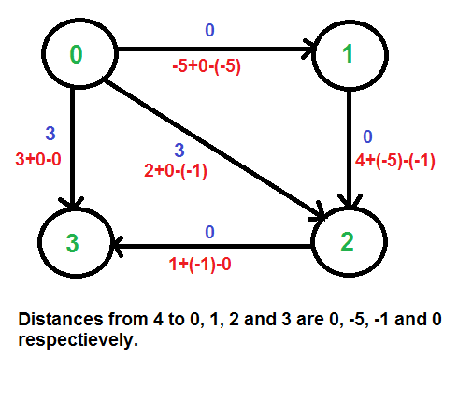

Johnson’s Algorithm
We calculate the shortest distances from 4 to all other vertices using Bellman-Ford algorithm.
The shortest distances from 4 to 0, 1, 2 and 3 are 0, -5, -1 and 0 respectively,
i.e., h[] = {0, -5, -1, 0}.
Once we get these distances, we remove the source vertex 4 and reweight the edges using following formula.

Slide 31
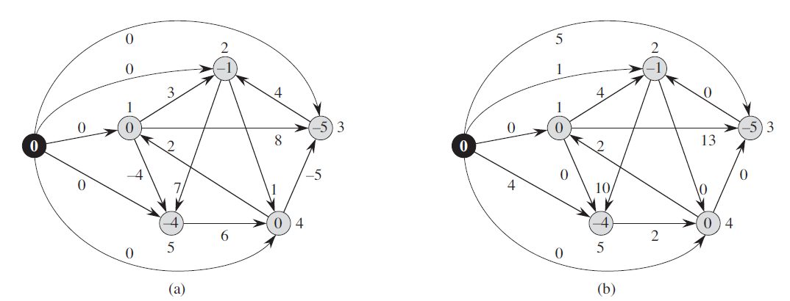
Johnson’s Algorithm

Slide 32
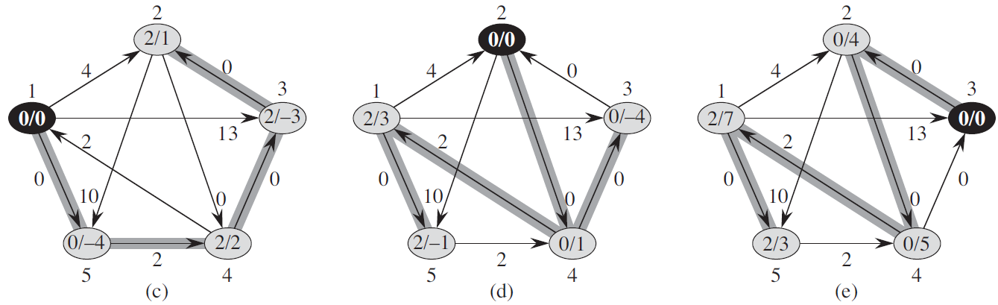
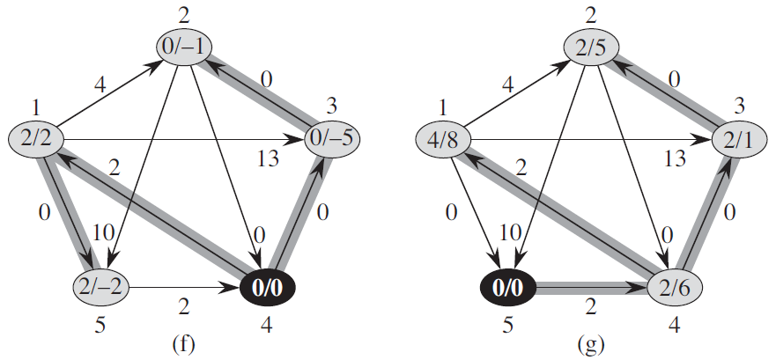
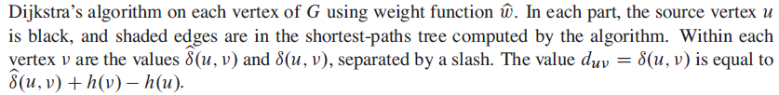

Slide 33
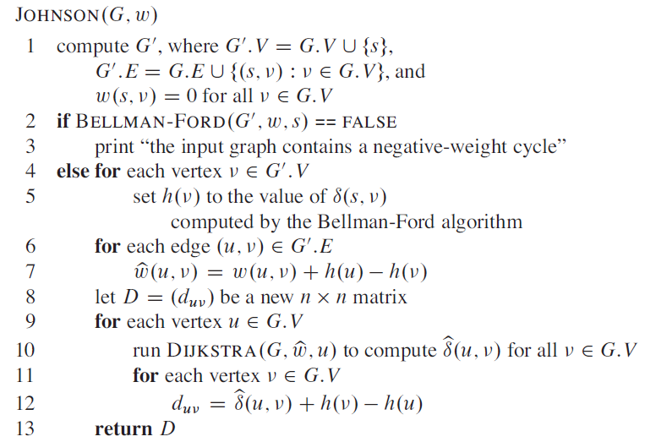

Slide 34
